Slide 1
Pizza Ordering System
MADE BY:
Ahmet Arda Öz
Melisa Karadağ

Slide 2
Introduction of system
In the pizza ordering method, customers select their own pizza menu. If customers do not wish to choose from an existing menu, they can create their own.

Slide 3
PROPOSED SYSTEM
Our project differs from other ordering system projects in that it allows users to construct their own own menu.

Slide 4
Requirements
There are two kinds of requirements:
Functional
Non-functional

Slide 5
Functional Requirements
The consumer can construct their own menu with our materials. They can choose from a variety of solutions if they don't want to produce.

Slide 6
Non-functional Requirements
Three separate menus, ten ingredients, and varied thicknesses of pizza dough must all be supported by the system.

Slide 7
Scenarios
We have two different scenario for admin and user

Slide 8
User Scenario:
User logs into the system
User looks at the menus, if they want to choose a menu they will choose it, if not they will create their own menu.
If the user chooses menu button, he will have 3 existing menus will show up.
If they choose the create menu option, they will be presented with a screen with ingredients, bread thickness, sauce, extras, and drinks.
Menu information will go to Payment
The user should check the menu information for the last time and make that decision if they want to cancel

Slide 9
Admin Scenario
Admin logs into the system
Admin can adjust the products in the shop
Confirms the user’s order

Slide 10
Our models

Slide 11
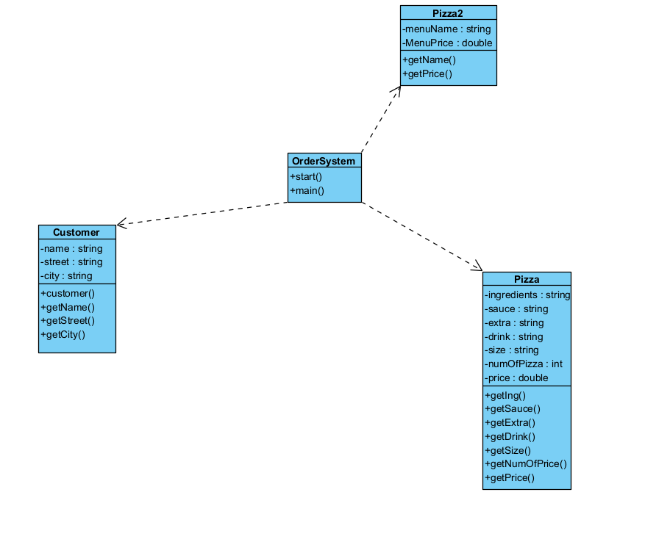
UML DIAGRAM (DRAFT )

Slide 12
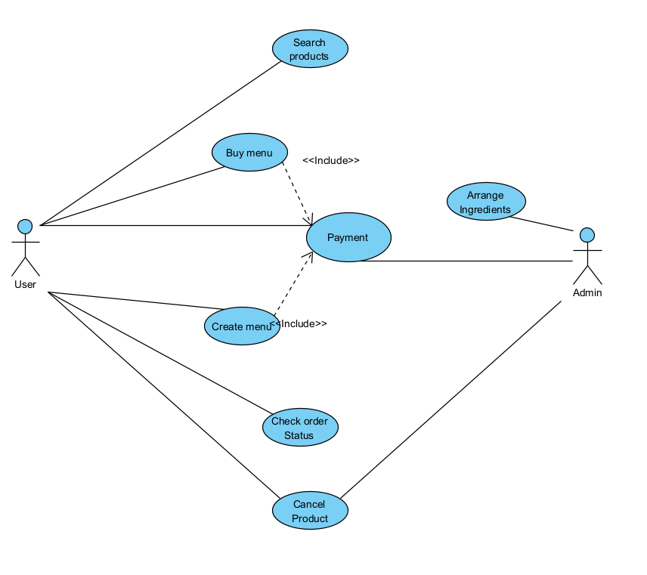
USE CASE DIAGRAM

